Slide 1
Dwellings prices in the DC metropolitan area
By Christopher Montgomery , Abhishek Nimmakayala , Swetha Kalla , Mojahid Osman

Slide 2
Are dwellings in the DC metropolitan area priced significantly differently from one another based on quadrant?
Primary SMART Question

Slide 3
Secondary Smart Question:
Do dwellings in different DC quadrant’s share similar characteristics?
How do dwelling characteristics contribute to DC house prices?
Average Dwelling Age
Date of last refurbishment (Year, treated as continuous)
Number of Bedrooms
Type of Dwelling
Number of Baths
Square footage
Air Conditioning (categorical)
Stories
Kitchens
Fireplaces
Condition (categorical)
Land Area of Property
Dwelling Type (cateogorical)

Slide 4
Source Data
The source data housing dataset created by DC.gov (obtained on Kaggle), containing dwelling characteristics for all homes in DC.

Slide 5
Data Glossary
Variable | Description
BATHRM | Number of Full Bathrooms
HF_BATHRM | Number of Half Bathrooms (no bathtub or shower)
HEAT | Heating
AC | Cooling
NUM_UNITS | Number of Units
ROOMS | Number of Rooms
BEDRM | Number of Bedrooms
AYB | The earliest time the main portion of the building was built
YR_RMDL | Year structure was remodeled
EYB | The year an improvement was built more recent than actual year built
STORIES | Number of stories in primary dwelling
SALEDATE | Date of most recent sale
PRICE | Price of most recent sale
QUALIFIED | Qualified
STYLE | Style
STRUCT | Structure
GRADE | Grade
Data Glossary (Continued)

Slide 6
Data Glossary (Continued)
Variable | Description
CNDTN | Condition
EXTWALL | Extrerior wall
ROOF | Roof type
INTWALL | Interior wall
KITCHENS | Number of kitchens
FIREPLACES | Number of fireplaces
LANDAREA | Land area of property in square feet
SOURCE | Raw Data Source
LIVING_GBA | Gross building area in square feet
FULLADDRESS | Full Street Address
ZIPCODE | Zip Code
LATITUDE | Latitude
LONGITUDE | Longitude
ASSESSMENT_NBHD | Neighborhood ID
WARD | Ward (District is divided into eight wards, each with approximately 75,000 residents)
SQUARE | Square (from SSL)
QUADRANT | City quadrant (NE,SE,SW,NW)

Slide 7
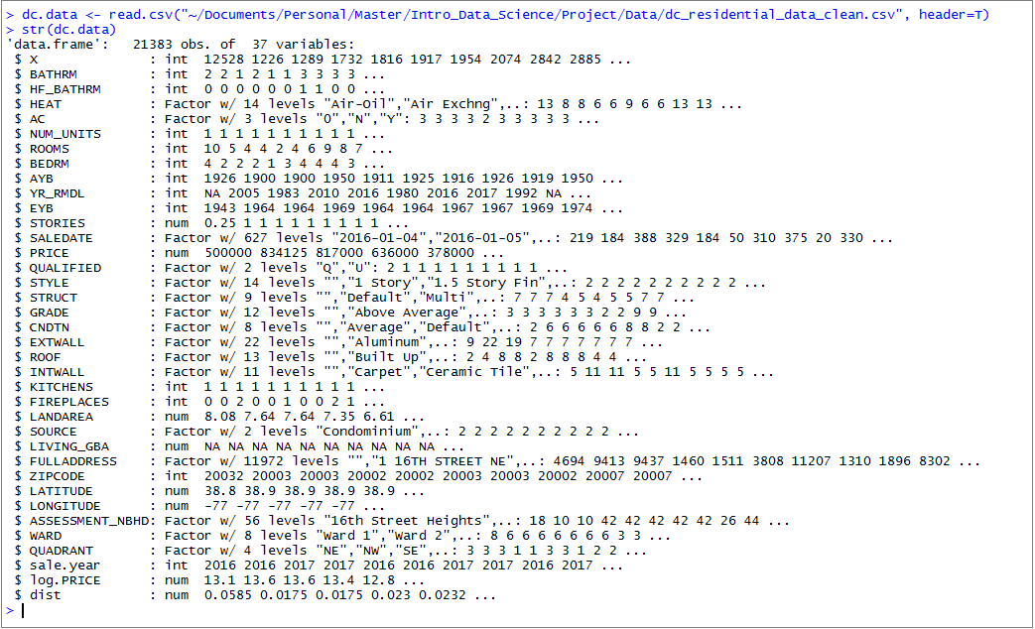
Data Glossary (Continued)

Slide 8
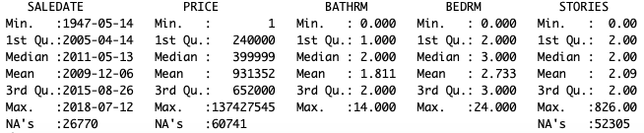
Initial Data
Total Observations – 158,957
Observations Containing Price Data- 98,216
Time Range of Housing Price Data – 1947 to 2018

Slide 9
Part 1: Data Prep Raw Data – Outlier Removal
Notes:
To begin our analysis we first inspected our data for outliers/inaccurate entries. However, given the highly skewed nature of many of our variables (bedrooms, rooms, bathrooms, etc.) we had concerns about using Tukey’s fences method.

Slide 10
Data Prep Clean Data
Notes:
Likewise, we had discussions regarding what values constitute as unreasonable and should be removed? Are DC home prices over 6 million unreasonable?
As such, we decided to visually inspect continuous variables and assign thresholds containing discontinuities.

Slide 11
Part 2: Analysis of DC dwelling characteristics

Slide 12
Part 3: Regression Analysis
Primary Research Questions:
How are individual dwelling characteristics related to house prices?
Are there significant differences in DC house prices between quadrants, even when controlling for dwelling characteristics?
Notes:
For the third part of our EDA project, we decided to run linear regression models to measure the relationship between DC housing prices and quadrant, while controlling for other housing characteristics.
For this section, we are primarily concerned with:
“How does each individual dwelling characteristic related to house price?”
“Do DC house prices differ between quadrant, even while controlling for dwelling characteristics?”

Slide 13
Feature Selection

Slide 14





Collinearity Concerns

Slide 15
Model Fitting

